Slide 1
EVALUATING THE READINESS FOR EV-BASED EVACUATION
Osman Saleem, UC Santa Cruz
Dr. Clotilde Robert, UC Merced

Slide 2

Background
Resilience Indicator Development
Basic Scoring Methodology
Expanding Resilience Indicator Development (36 Indicators)
Advanced Scoring Methodology
2ND

Slide 3
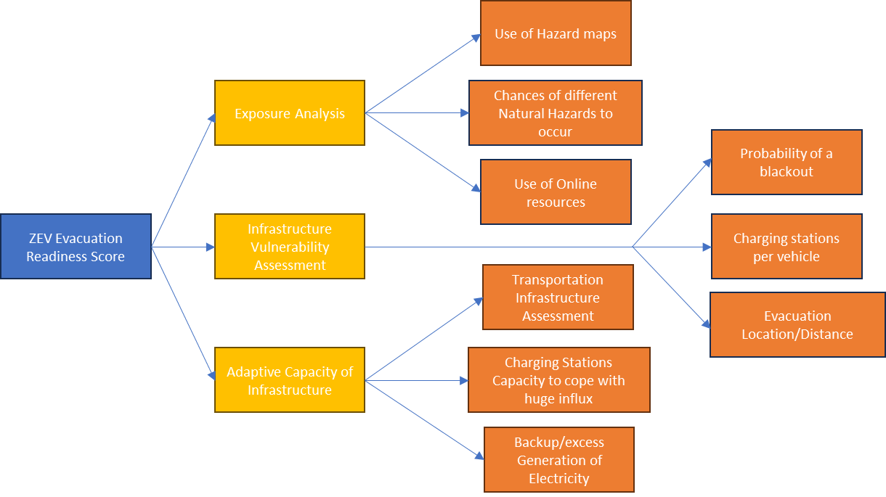
Resilience Indicators (1st Year)

Slide 4
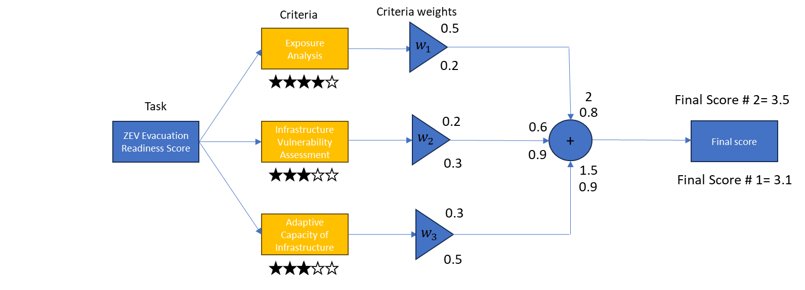
Basic Scoring Methodology (1st Year)

Slide 5
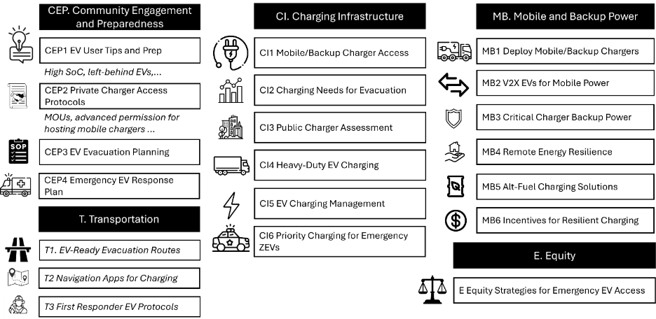
Resilience Indicator Expansion Designed for Communities

Slide 6






Scoring Design And Indicators Expansion
Q: Why was there a need of scoring design to get a score for the region?
Q: Why was there a need of reviewing the Indicators list and domains?
Making it easier for everyone to decipher what would it mean to have the best score. Improving collaborations for making it easier for authorities to make the score better.
Some domains like "Exposure Analysis" are not applicable and only play a role in understanding the risk while the focus should be on dealing with the risk.
The aim was to develop one scoring methodology to be used by every state/region/county/city to define their own score.
Developing a set of indicators spanning every domain so that a scoring methodology is not vague and captures every possible scenario in case of actual evacuation.
Developing a score that can be back tracked to understand which set of indicators/domains need to be revisited and improved to increase the overall score for the region.
Making sure that these set of indicators can be implemented to any kind of temporal stage i.e. pre-disaster, during disaster and post-disaster stage.

Slide 7
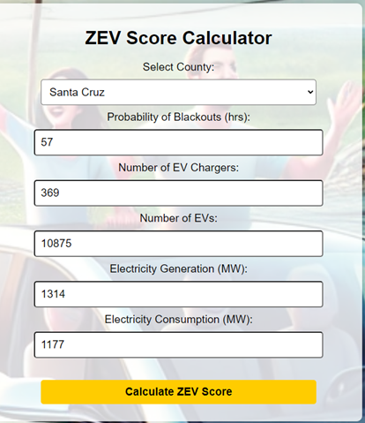
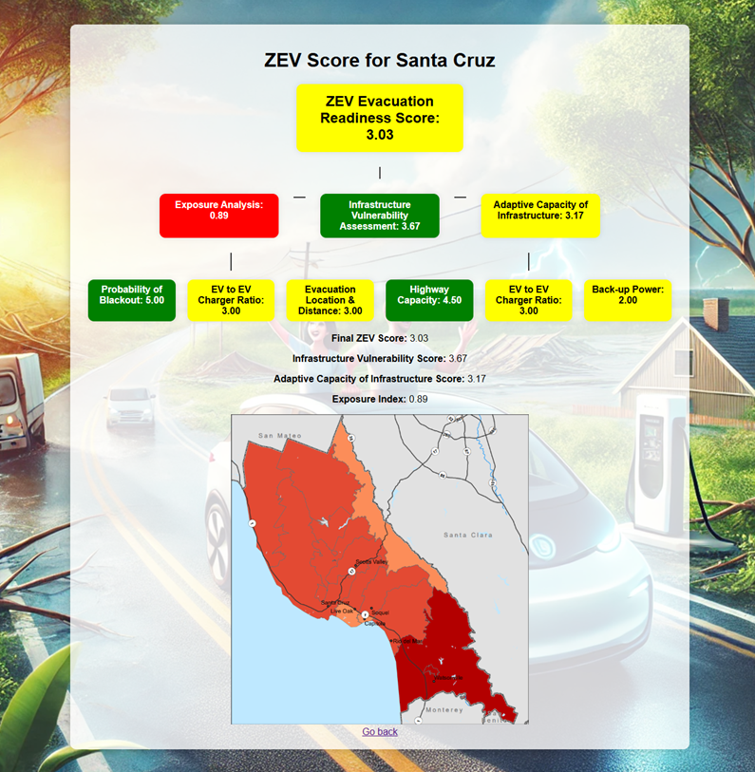
Basic Scoring Methodology

Slide 8
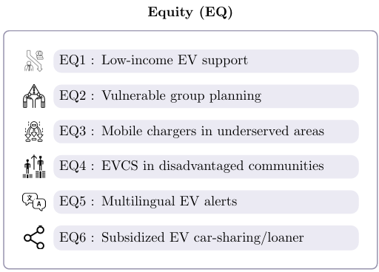
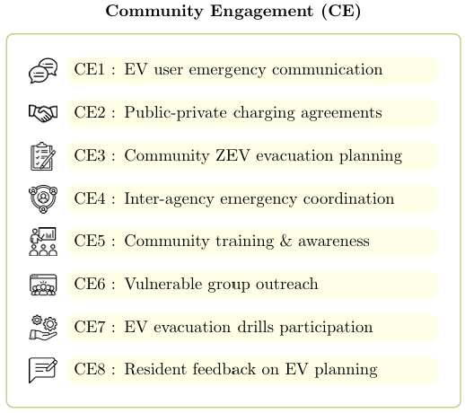
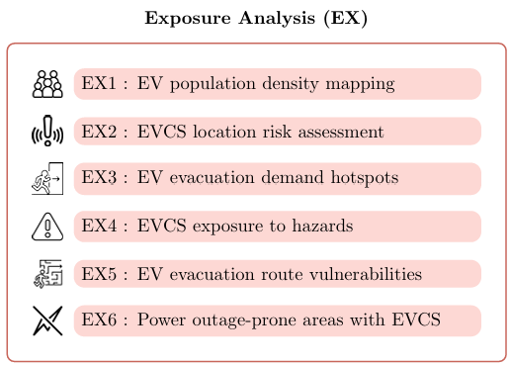
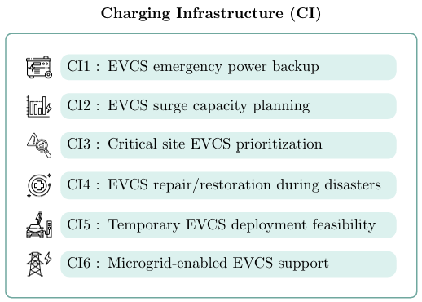
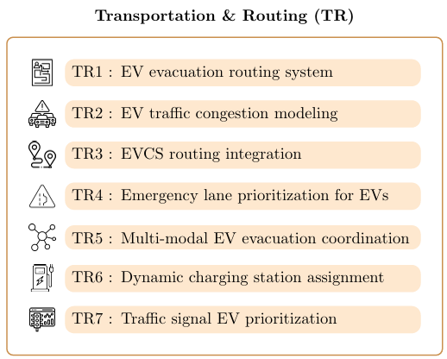
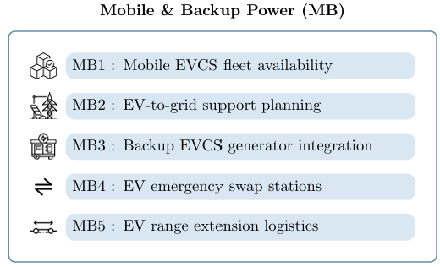
Scientific Resilience Indicator Expansion Design

Slide 9
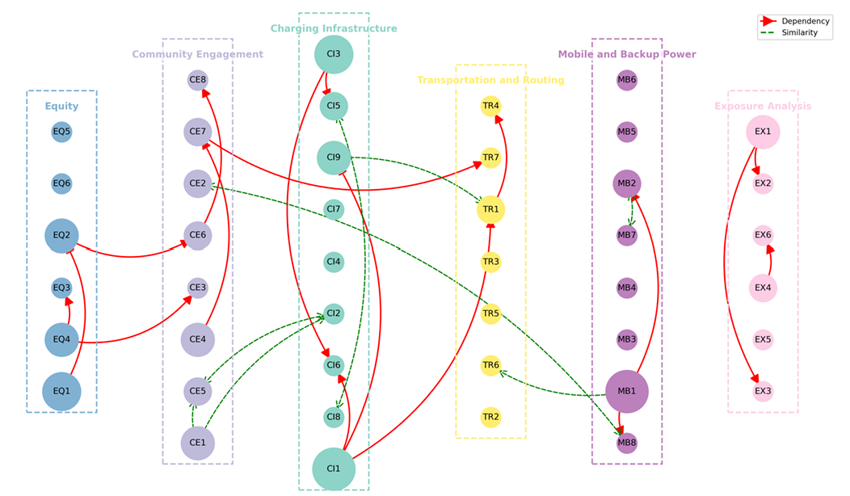
Resilience Indicator cross-domain similarities & Interdependencies

Slide 10
But how can we advance this research to develop an "Advanced Scoring Design"?

Slide 11
A Tool to Evaluate Readiness for EV-Based Evacuations Dr. Clotilde Robert

Slide 12


Context and Goal
This work follows the report just presented by Osman.
Key question for all counties:
Are we ready to evacuate with EVs?
Objective
Provide communities with a way to self-assess their readiness for EV-based evacuations.

Slide 13
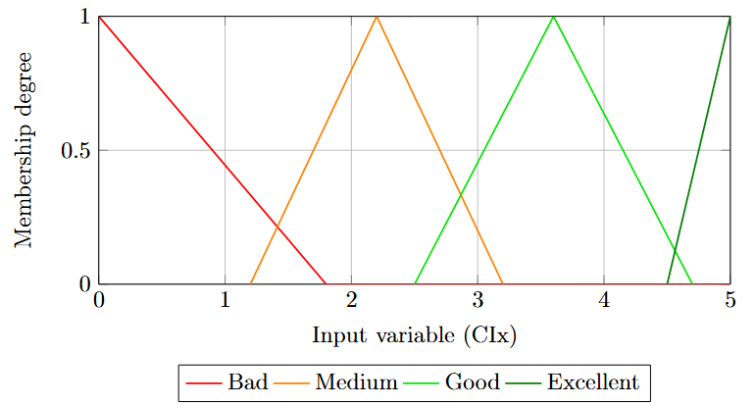
How it Works
Level | Criteria met | Description
Bad (0–1.8) | No evidence of estimation | No documented estimation of power/energy needs for EV-based evacuation. No consideration of load surges or energy constraints during evacuation.
Medium (1.2–3.2) | 1 factor considered (rough estimate) | Community has begun estimating total evacuation energy needs, but the approach is limited or not scenario-based. No formal tool use or methodology. Estimates are qualitative or rely on rough calculations.
Good (2.5–4.7) | 2 to 3 key factors estimated + partial use of tools or structured method | Community has quantified energy needs based on some variables (e.g., number of EVs and charging needs). Basic modeling or tool use (even if informal or partial). Results inform planning discussions but are not yet formalized.
Excellent (4.5–5) | Estimations conducted across at least 4 key factors + modeling tool used + integrated into planning | The community has estimated evacuation energy needs by scenario, including at least 4 of the following: number of EVs, evacuation distance, initial battery state, number of stations, time to evacuate. Uses tools such as EVI-X Toolbox or equivalent. Estimates are documented and considered in emergency or energy planning documents.
Start with scoring tables
Example
Indicator CI2 : Estimation of energy needs

Slide 14
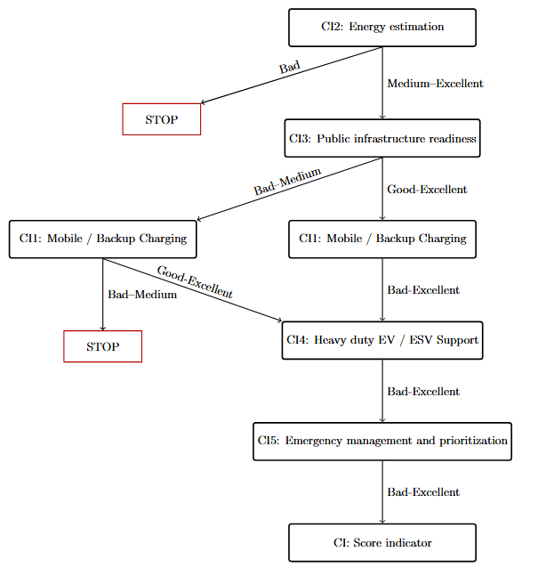
How it Works
Charging Infrastructure Decision Tree
2. Decision Tree
The scores are combined logically using a decision tree.
1
Each branch represents a step.
2
At the end: a final score between 0 and 5.
3

Slide 15
Case Study: Mariposa County
Example
Results overview for each indicator (0–5 scale)
CI2 – Energy needs estimation → 4/5 (Good) Strong energy estimation and planning (see afternoon case study), but more scenarios and coordination with Mariposa County are needed to finalize planning documents.
CI4 – Heavy duty / ESV support & CI5 – Emergency management and prioritization → 1.5/5 (Bad-Medium) No heavy-duty EVs or charging protocols; planning interest but no implementation yet.
CI3 – Public infrastructure readiness → 4/5 (Good) Good BEV-to-charger ratio, adequate coverage, and active planning, but full implementation is still pending.
CI1 – Mobile/Backup Charging → 3.5/5 (Good) Limited demand, candidate sites identified (see afternoon case study), but no formal agreements yet.

Slide 16
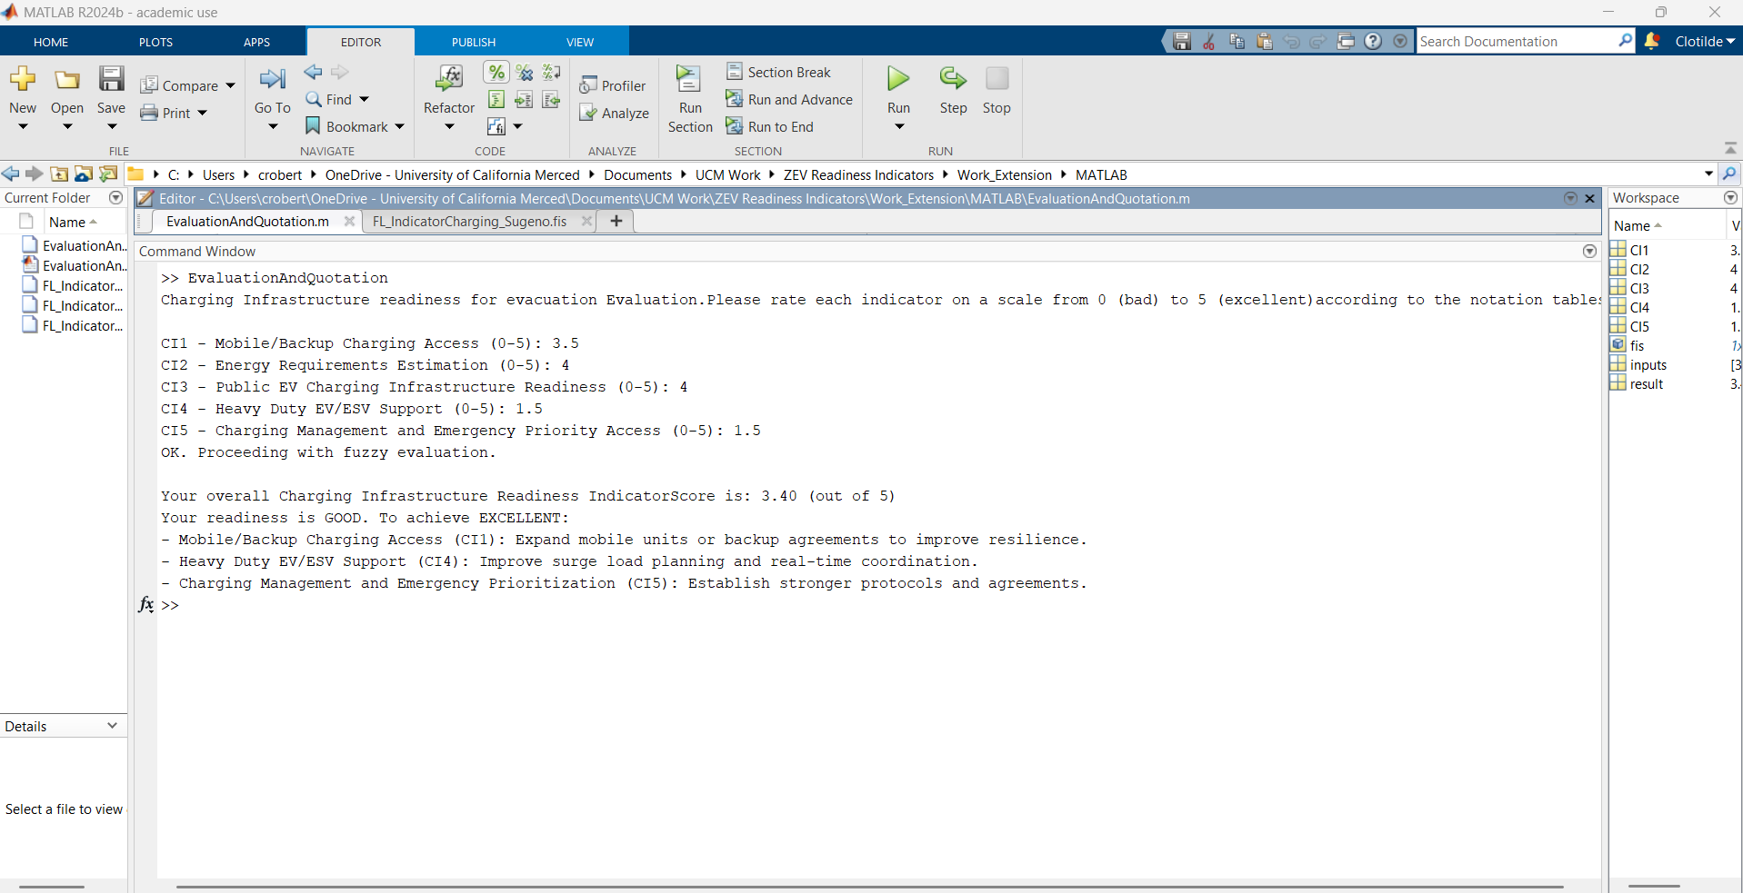
Case Study: Mariposa County
Example
>> EvaluationAndQuotation
Charging Infrastructure readiness for evacuation Evaluation.Please rate each indicator on a scale from 0 (bad) to 5 (excellent)according to the notation tables:
CI1 - Mobile/Backup Charging Access (0-5): 3.5
CI2 - Energy Requirements Estimation (0-5): 4
CI3 - Public EV Charging Infrastructure Readiness (0-5): 4
CI4 - Heavy Duty EV/ESV Support (0-5): 1.5
CI5 - Charging Management and Emergency Priority Access (0-5): 1.5
OK. Proceeding with fuzzy evaluation.
Your overall Charging Infrastructure Readiness IndicatorScore is: 3.40 (out of 5)
Your readiness is GOOD. To achieve EXCELLENT:
- Mobile/Backup Charging Access (CI1): Expand mobile units or backup agreements to improve resilience.
- Heavy Duty EV/ESV Support (CI4): Improve surge load planning and real-time coordination.
- Charging Management and Emergency Prioritization (CI5): Establish stronger protocols and agreements.
>>

Slide 17

Next Steps
This tool now needs your expert feedback.
It also needs to be expanded to other categories beyond charging infrastructure.
Let’s move to the interactive session, we will count on your input to evaluate and refine the scoring tables.

Slide 18
Interactive session Assessing evacuation readiness Dr. Clotilde Robert Osman Saleem

Slide 19
Instructions for the Interactive Session
Goal of the session
Collect feedback to refine and validate the indicators scoring tables
Notes:
Keep only the third objectif

Slide 20




Instructions for the Interactive Session
What to do
Discuss within your group:
Are the current scoring ranges (e.g., 0–1.5) appropriate?
Should they be adjusted (e.g., 0–1.2)?
Are the level descriptions (Bad / Medium / Good / Excellent) clear and realistic?
Work in groups by area of expertise
Propose modifications if needed (ranges, descriptions, recommendations)
Review the scoring tables

Slide 21
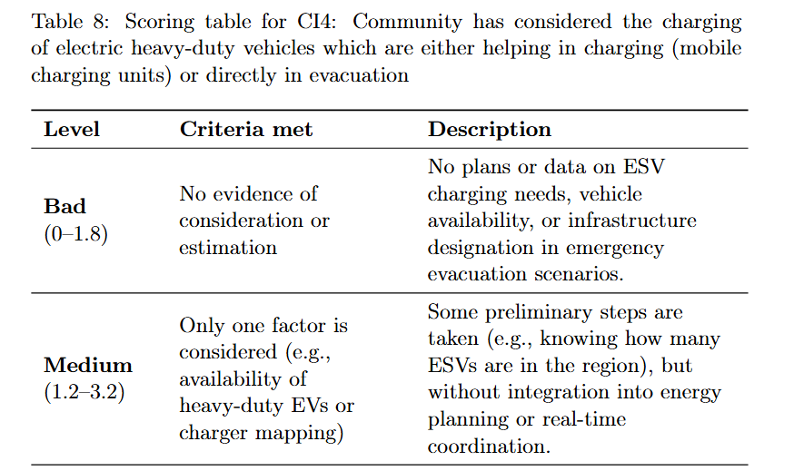

Instructions for the Interactive Session
Is this medium level difficult to reach? Maybe the current definition of medium is not appropriate.
Example
This scoring range can be adjusted, for example it could be 0–1.
Group 1
This description better fits the 'Good' level and should be moved there
Group 2
Propose new score from 0-1

Slide 22
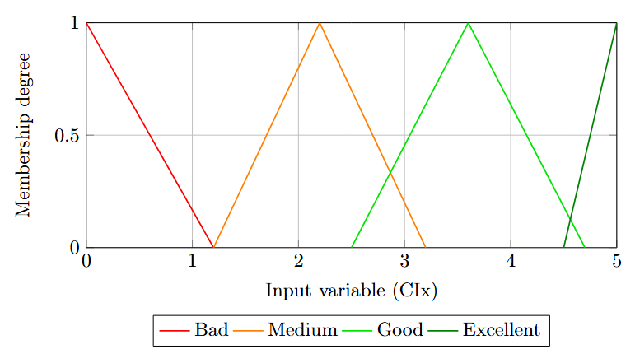
Instructions for the Interactive Session
Example
Triangular membership functions for initial input variable
Triangular membership functions for new input variable

Slide 23


Instructions for the Interactive Session
Materials Provided
Timing
Scoring tables for all indicators
ZEV Readiness Indicators Report
Box Folder UC Merced
1
00:20:00
Group discussion
2
00:10:00
Write down your comments (you may add notes directly on the PDF files)
3
00:05:00
Group feedback: one person per group gives a 1-minute summary

Slide 24
Instructions for the Interactive Session
Group Allocation
Group number | Indicator | People
1 | Community Engagement & Equity | K. Corzine (UCSC); Adam (Merced County); Ricardo (UCM); Raquel (Mariposa)
2 | Charging Infrastructure | Joseph (Even Recharge); Qijian (UCB); Joseph (UCM); Captain W. Smith (Mariposa)
3 | Mobile and Backup Power (online session) | Bethany (Clovis); Katraman (LBL); Noah (Perimeter platform); Natalie (CARB)
4 | Transportation | Wonuola (Central CAL Asthma); Saeed (UCSC); Ali (UCM); Xuchang (UCD); Sgt. Rumfelt (Mariposa)
(This allocation is a suggestion — participants may switch groups if they wish, except for the online group, which must remain fixed.)

